Slide 1
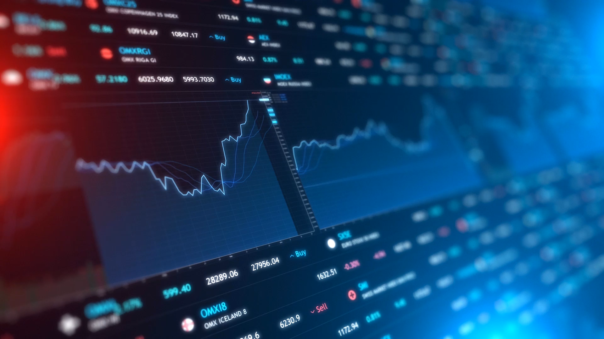
Predictive Forecasting & Financial Analysis
Venkat Pinnika
Michael Epps
Janice Ambrose
Young You

Slide 2
Agenda
Introduction
Project Goal
Tools and Technologies
Collecting the Historical Data
Choosing the ML Models
Prediction Evaluation
Financial Analysis
Display results to the user
Challenges and Learnings
Conclusion

Slide 3
Introduction
Predicting how the stock market is one of the most difficult things to do. There are so many factors involved in the prediction – physical factors vs. physiological, rational and irrational behavior, etc. All these aspects combine to make share prices volatile and difficult to predict with a high degree of accuracy.
Can we use machine learning as a game changer in this domain?
In this project, we worked with historical data about the stock prices of a publicly listed company. We implemented a mix of machine learning algorithms to predict the future stock price of this company, by using the algorithms like Simple Linear Analysis, and K Nearest Neighbor (KNN).

Slide 4
Project Goal
By using historical data and ML algorithms, generate more accurate forecasting results
Provide the parameter feature to enter the stocks dynamically
Provide features for Single / Multi stock analysis
Analyze / Compare the stocks to buy/sell
Display results to the user
Use this application for future stock/financial analysis

Slide 5
Tools & Technologies
Python Pandas
Matplotlib
SciKit-Learn
JavaScript
Web Scraping
Flask

Slide 6
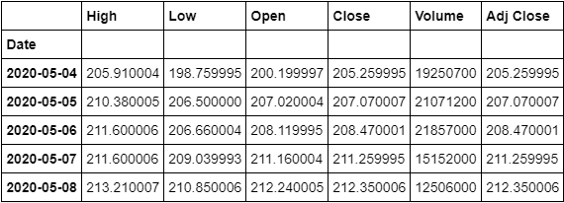
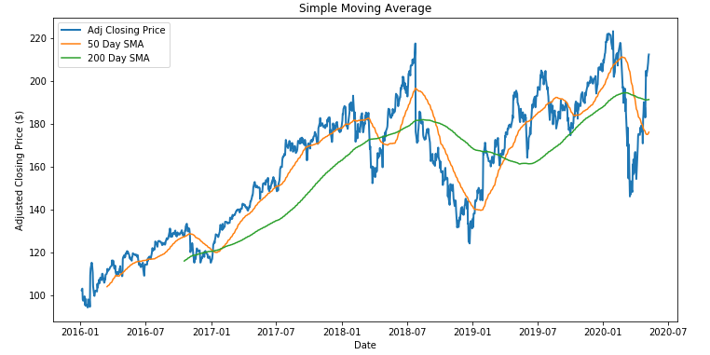
Collecting the Historical Data
Used Yahoo Finance API as data source for historical data
Used these Pandas libraries
import pandas_datareader.data as web
stocks_df = web.DataReader('FB', 'yahoo', start_date, end_date)
ma_200day= closing_price_df.rolling(window=200).mean()

Slide 7
Choosing the ML Models to Predict Stock Prices
Machine learning models were used to predict our stocks:
Simple Linear Analysis
K Nearest Neighbor (KNN)
This helped us to predict values for our data points.

Slide 8
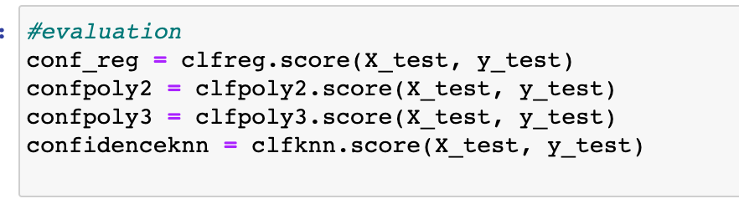
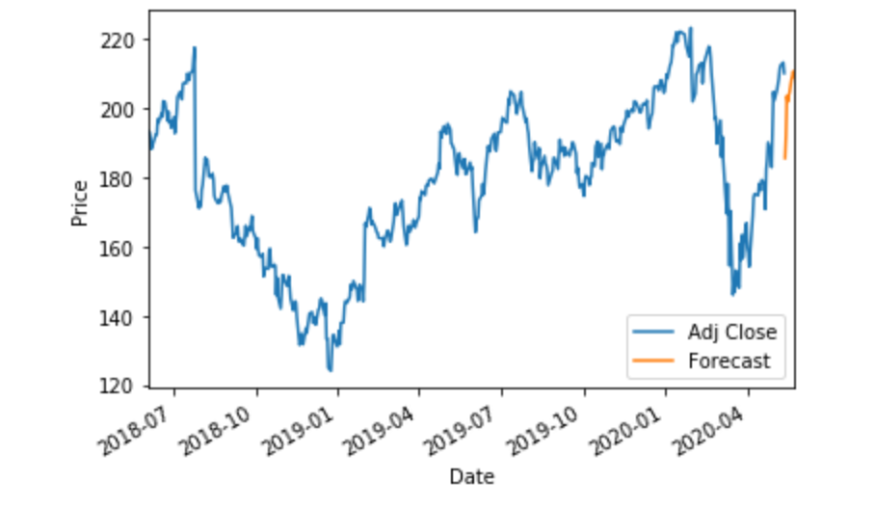
Prediction Evaluation
We used the score method to test the accuracy of each trained model

Slide 9
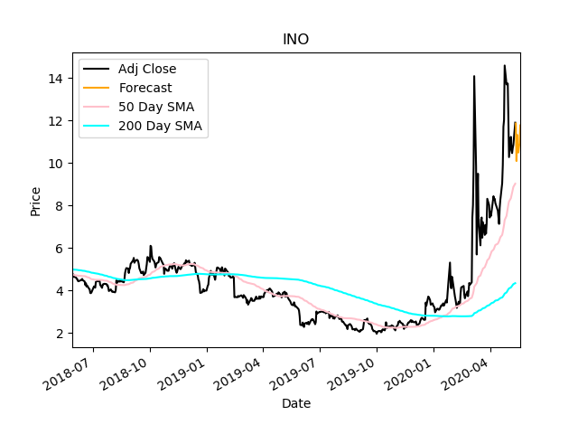
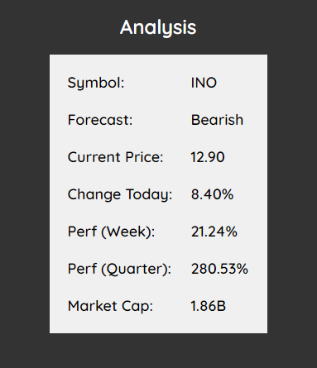
Financial Analysis
We can interpret our data in various ways. We can get an idea of how our stock has performed over different time periods. We can also make use of our technical indicators (moving averages) to get an idea of the stocks momentum. For example, INO has had a wild rally after the 50 crossed over the 200, but we have a short term bearish forecast on this chart as it cools off.

Slide 10
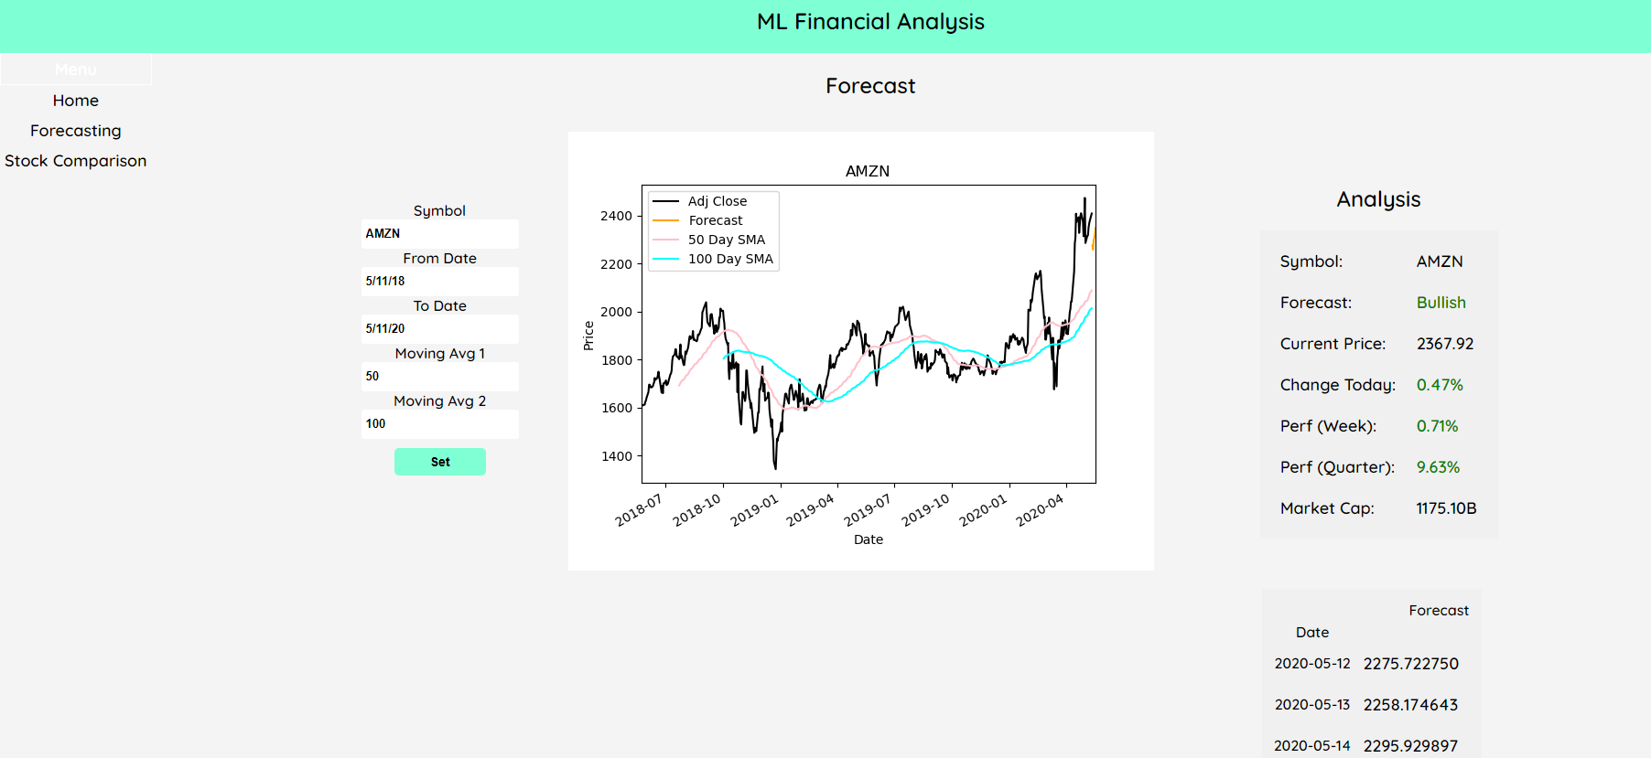
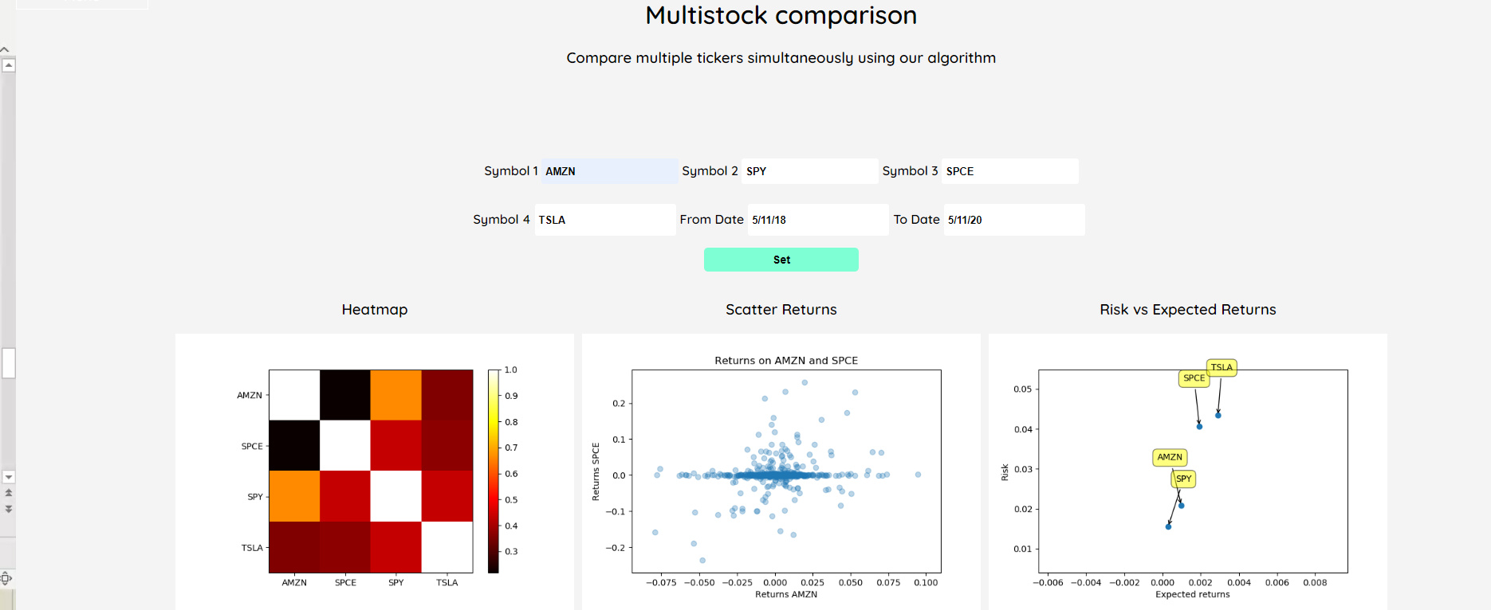
Display results to the user
We wrapped up our functionality into a clean, easy to use web app that takes user input and generates a quick analysis for you on the fly. You can run predictive models and compare multiple stocks at the same time.

Slide 11
Challenges and Learnings
Identify the APIs to collect historical data
Matplotlib errors plotting duplicate charts
Flask apps cache static files, App needed functionality to be refreshed to be dynamically updated on the fly
Had to learn to use form submissions and GET/POST requests with flask to get user input
Extending the predictions to one year
Figuring out which algorithm would work best with stock prediction

Slide 12
Conclusion
As you will see, our models is not perfect, but they can try to give you an idea of what a stock may do or how it behaves.
Machine learning can be very useful in the financial field, in fact some financial institutions are already using it.
Building a good algorithm takes time and patience, but it will still not be perfect. Considering how the stock market is behaving recently, making any sort of prediction may be difficult, but has the potential to be very worth while.

Slide 13


Slide 14
Demo Presentation

Slide 15


